Slide 1
FE Dev with React vetting

Slide 2
Git conflict ---- merge
ANSWER : An event when Git is unable to resolve differences in code between the two commits automatically.
git stash is
ANSWER: takes your modiliels and save on stack of infinished changes to reapply at any time.
git diff-tree –r {commit hash}
ANSWER: GET a list of file from particular commit
REBASE : re-writes the project history by creating brand new commits
ANSWER : GIT REBASE

Slide 3
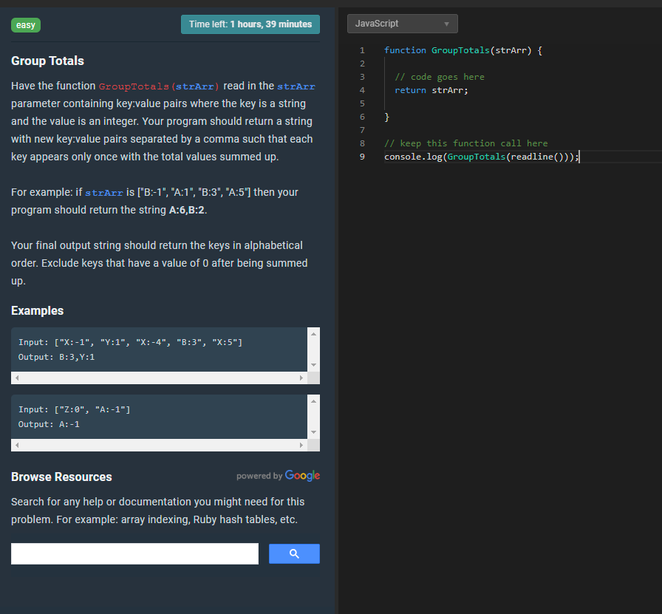

Slide 4
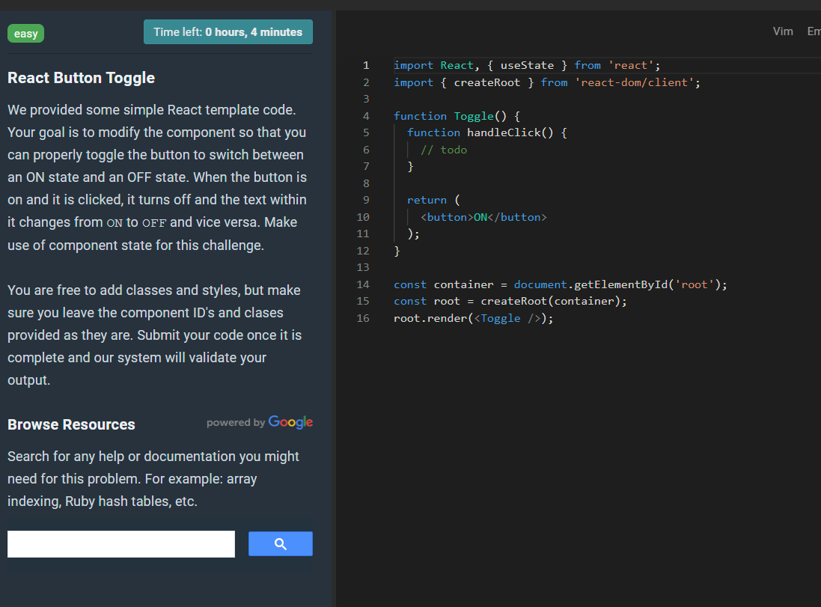

Slide 5
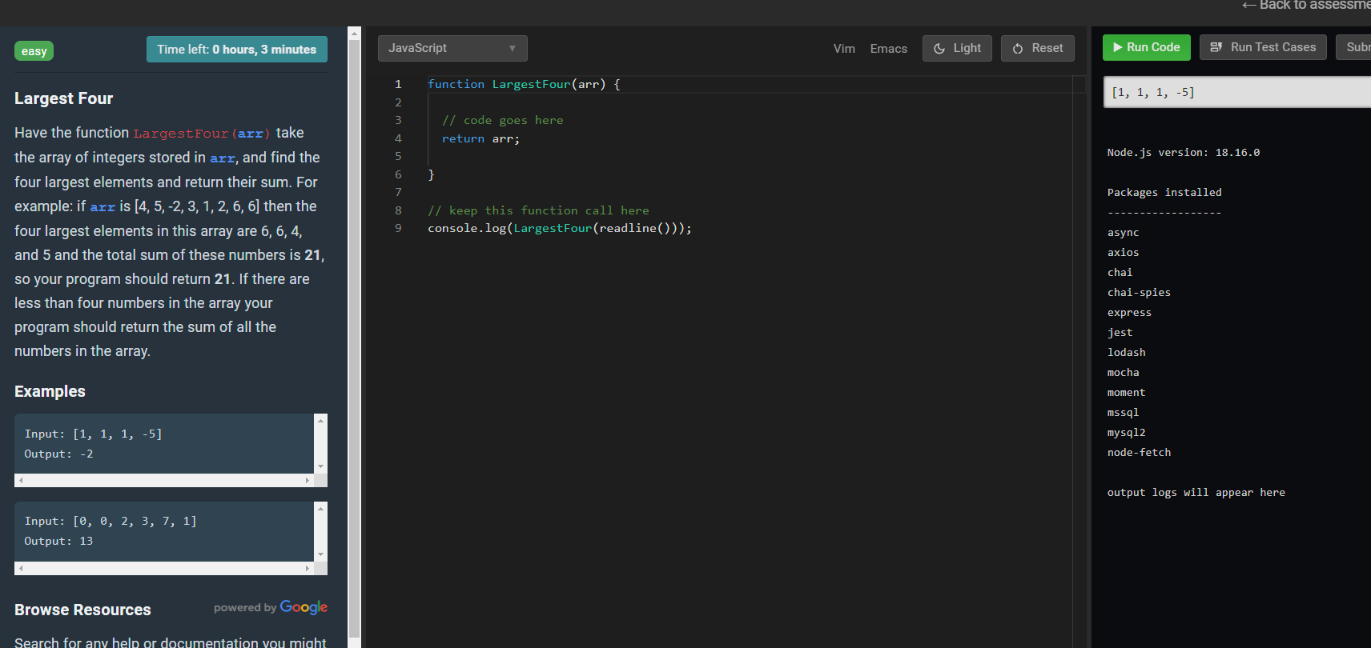

Slide 6
function GroupTotals(arr: string[]) {
// transform to Array of Object
let arrObj = []
for (let i = 0; i < arr.length; i++) {
const [first, last] = arr[i].split(":")
const newObj = { prop: first, propValue: parseInt(last) }
arrObj.push(newObj)
}
//console.log(arrObj[0])
// Group and Sum By Props
const resultSum = arrObj.reduce(sumByProps, {})
//console.log(resultSum)
// Clean array and transform to Array of
let summedItems = []
for (let [key, value] of Object.entries(resultSum)) {
//console.log(key, value)
if (value !== 0) {
//console.log(`${key}:${value}`)
summedItems.push(`${key}:${value}`);
}
}
return summedItems.sort().join(",");
}
function sumByProps(acc: { [key: string]: number }, val: { prop: string, propValue: number }) {
//console.log(acc, val)
// If object is empty, accept first iteration
if (Object.keys(acc).length == 0) {
acc = { [val.prop]: val.propValue }
} // If object has same property, make a sum.
else if (acc.hasOwnProperty(val.prop)) {
//console.log('SUM', acc[val.prop], val.propValue)
acc = { ...acc, [val.prop]: acc[val.prop] + val.propValue }
}
// not empty object, but accept new prop.
else if (!acc.hasOwnProperty(val.prop) && Object.keys(acc).length !== 0) {
acc = { ...acc, [val.prop]: val.propValue }
}
//console.log(acc)
return acc
}
const test1 = ['X:-1', 'Y:1', 'X:-4', 'B:3', 'X:5']
const test2 = ['X:10', 'Y:0', 'X:-4', 'B:3', 'X:5', 'B:3']
console.log(GroupTotals(test1))
console.log(GroupTotals(test2))

Slide 7
import React, { useState } from "https://esm.sh/react";
import { createRoot } from "https://esm.sh/react-dom/client";
function App() {
const [tog, setTog] = useState(true);
function handleClick() {
setTog(!tog);
}
return (
<>
<h1>{tog ? "ON" : "OFF"}</h1>
<button onClick={handleClick}>Toggle</button>
</>
);
}
const cont = document.getElementById("app");
const root = createRoot(cont);
root.render(<App />);
class App extends React.Component {
constructor() {
super();
this.state = {
switch: true,
};
this.updateToggle = this.handleClick.bind(this);
}
handleClick() {
this.setState((prevState) => ({ switch: !prevState.switch}) );
}
render() {
return (<button onClick={this.updateToggle}>
{this.state.switch ? 'ON' : 'OFF' }</button>);
}
}
React.render(<App />, document.getElementById('app'));

Slide 8
function large(arr) {
const SIZE = 4
arr.sort((a, b) => a - b).reverse()
//console.log(arr)
const cut = arr.splice(0, SIZE)
//console.log(cut)
let total = 0
for(let i = 0; i < SIZE; i++) {
total += cut[i]
}
return total
}
const test1 = [1, -1, 0, 4, 1, -5]
const test2 = [0, -1, 10, 5, 0, -5]
console.log(large(test1, 6))
console.log(large(test2, 4))

